Slide 1

Welcome to
Zippy Delivery
POWERPOINT TEMPLATE

Slide 2
Our Mentors
Mrs. Anjali Singhal
Mrs. Tabbassum Hassan
Mrs. Sangeetha
Mr. Rakesh Pandit

Slide 3
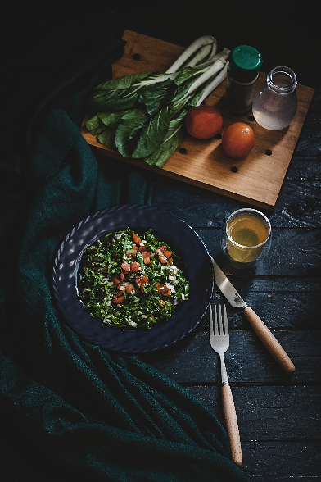

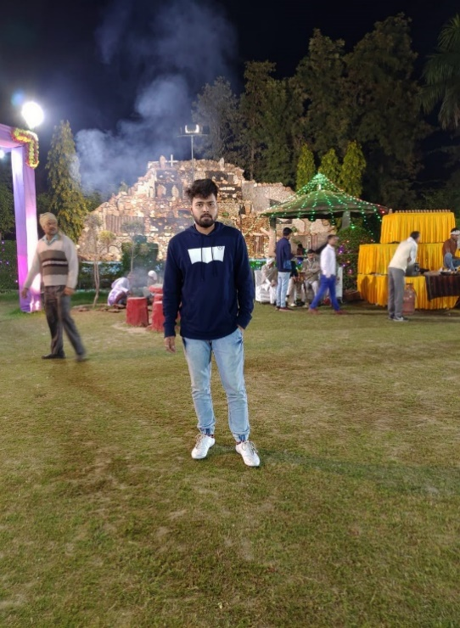


Zippy Delivery
🍕
Zippy Delivery
FOOD FEED
Presented By
Jayendra Kumar Singh
Chitkula Saikiran
Abhishek Sinha
FANTASTIC FOOD -

Slide 4

About Zippy Delivery..
DELICIOUS
Zippy Delivery is an Indian online food ordering and delivery platform. The main branch at Bangalore and operates in 10+ Indian cities .
Services : Food Ordering.

Slide 5
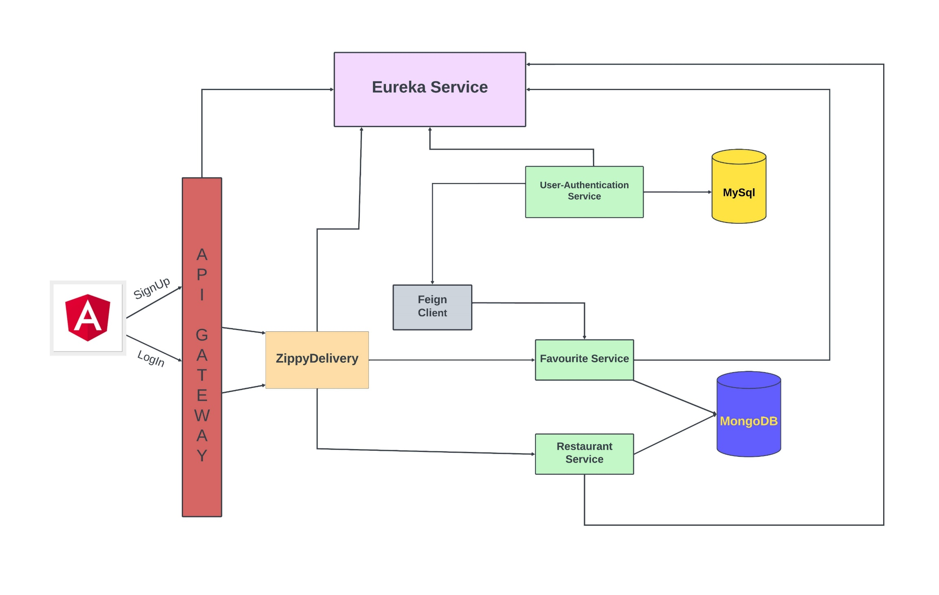
ARCHITECTURE DIAGRAM
Zippy Delivery

Slide 6
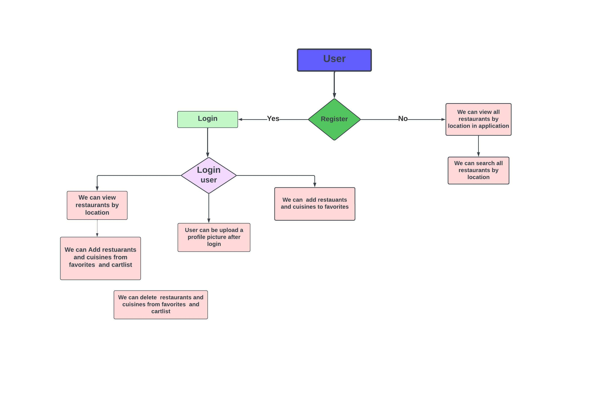
WORK FLOW-DIAGRAM

Slide 7
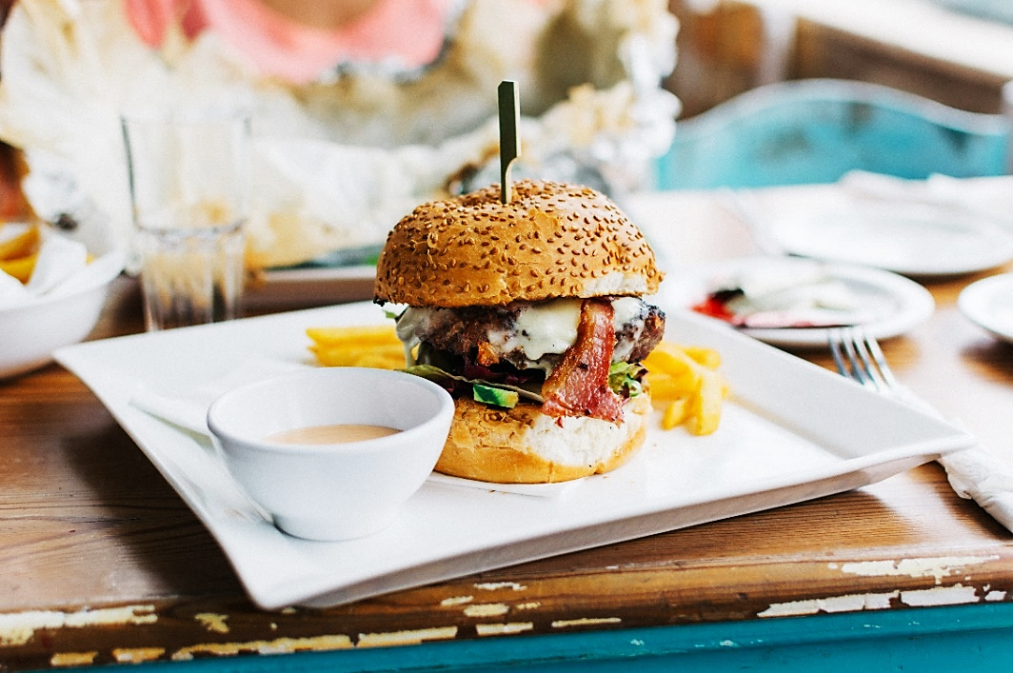
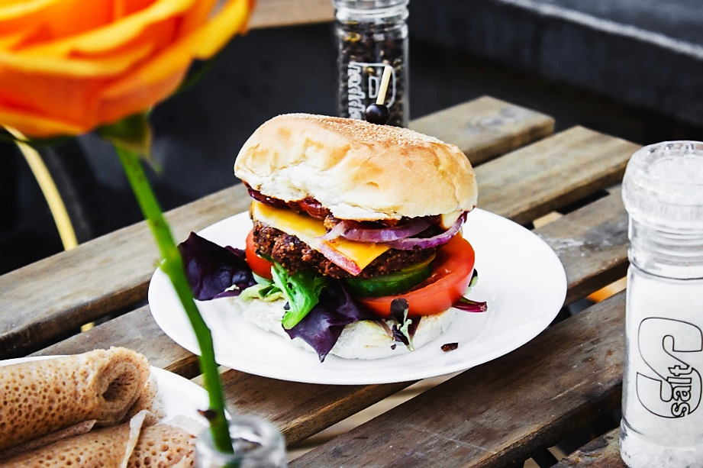
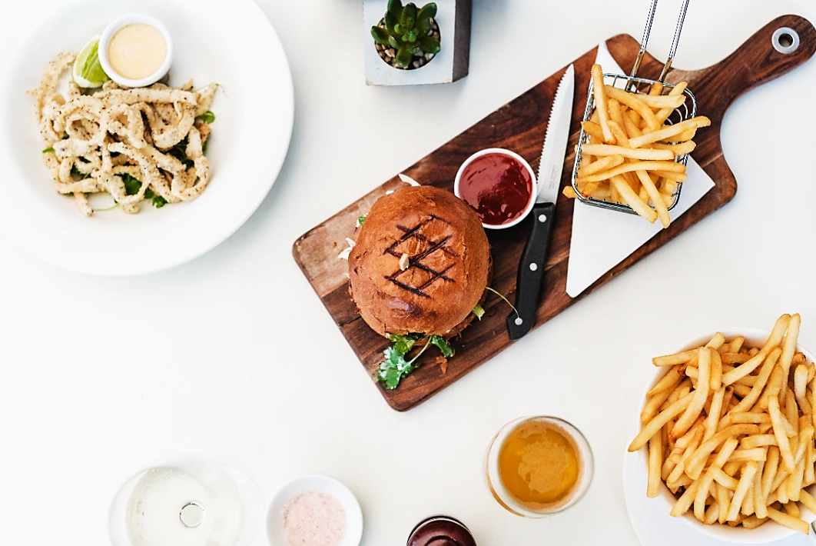
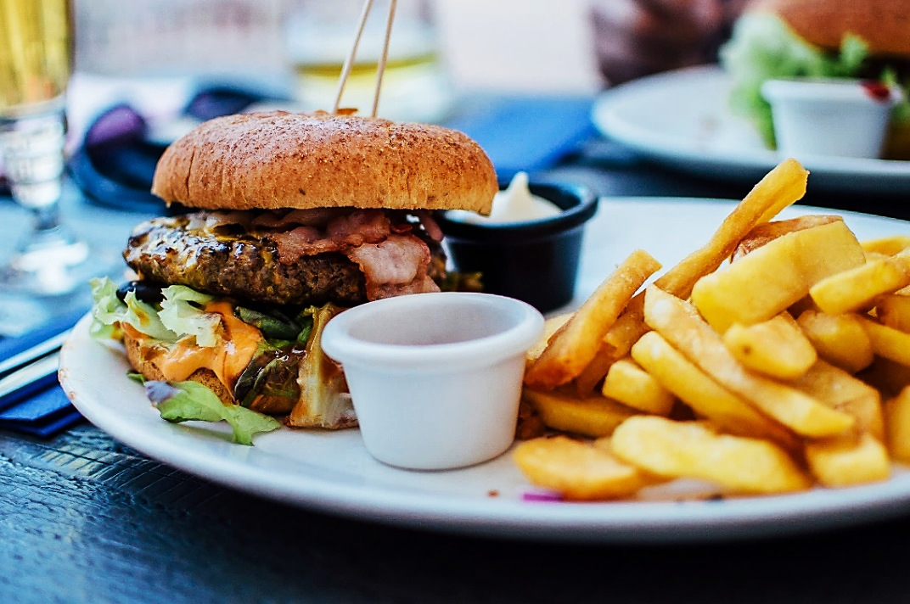
Zippy Delivery
FOOD FEED
In this App User will be able to register. A registered user will be able to login.
User can Search for restaurant and cuisine based on the location what we provided in the application.
User can be able to add his favourite restaurant and cuisine. You can order your food from the restaurant
User can View all favourite restaurants and cuisines under favourite section and can remove from favorite section .
Zippy delivery

Slide 8





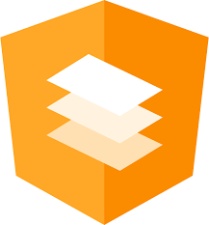
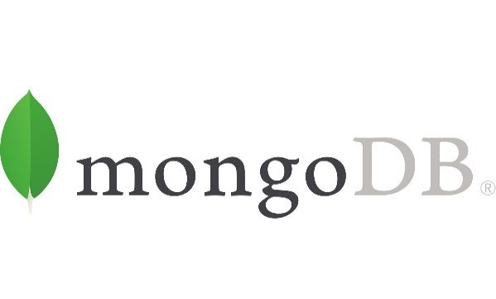




Technologies Used :
Zippy delivery

Slide 9

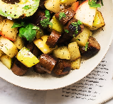
We Have implemented in Backend Application
Zippy delivery
API Gateway Service
Eureka server
JWT for Authentication
Feign Client

Slide 10
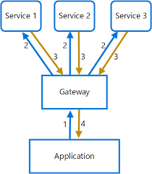
A P I Gateway Service
Zippy delivery
The API Gateway offers a reverse proxy to redirect or route requests to the endpoints of the internal microservices. We have used Spring Cloud’s API Gateway Service.
API stands for Application Program Interface. It is a server and it act as a single entry point into a system
It makes it possible for the user to access microservices without knowing their actual location .

Slide 11

Eureka Server
Eureka Server is an application that holds the information about all client service applications.
Each microservice will register into eureka server and it will knows all the client application running on each port and IP addresses.
So if one microservice wants to know address of another microservice they will go to eureka server to get the address of that specific microservice.
Eureka server is also known as Discovery Server.
Zippy delivery

Slide 12
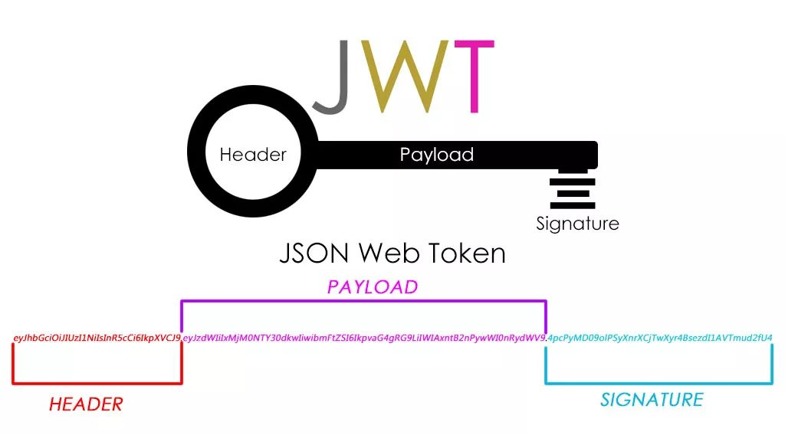
JSON Web Token For Authentication
It is a standard for token-based authentication.
JWTs are a good way of securely transmitting information between parties because they can be signed, which means you can be sure that the senders are who they say they are. Additionally, the structure of a JWT allows you to verify that the content
Zippy delivery

Slide 13

Feign Client
Feign Client is a declarative REST client in Spring Boot Web application. So if we are using feign client than we create an interface and annotate it.
In Synchronous communication , a chain of requests is created between the microservices while serving the client request.
With the help of feign client one microservice communicate with another microservice . It allows us to do with annotation.
Zippy delivery

Slide 14

Technologies
We Used In
Front-End
Zippy delivery

Slide 15
HTML & CSS
The Hyper Text Markup Language or HTML is the standard markup language for documents designed to be displayed in a web browser. It can be assisted by technologies such as Cascading Style Sheets.
CSS is the language we use to style an HTML document.
CSS describes how HTML elements should be displayed.
Zippy Delivery

Slide 16
Bootstrap
Bootstrap is a free and open-source CSS framework . It contains HTML, CSS and JavaScript-based design templates for typography, forms, buttons, navigation, and other interface components
Zippy delivery

Slide 17

Angular & Angular Material
Angular is an open-source, JavaScript framework written in TypeScript.
Its primary purpose is to develop single-page applications.
Angular Material is a User Interface (UI) component library that developers can use in their Angular projects to speed up the development of elegant and consistent user interfaces. Angular Material offers you reusable and beautiful UI components like Cards, Inputs, Data Tables, Toggle buttons and much more.
Zippy delivery

Slide 18

DataBases Used
Zippy Delivery

Slide 19
MySql :
MySQL is a database management system. A relational database stores data in separate tables rather than putting all the data in one big storeroom. The database structure is organized into physical files optimized for speed.
Zippy delivery

Slide 20
Mongo DB
Zippy delivery
MongoDB is an open-source document-oriented database that is designed to store a large scale of data and also allows you to work with that data very efficiently.
MongoDB stores data in flexible, JSON-like documents, meaning fields can vary from document to document and data structure can be changed over time

Slide 21
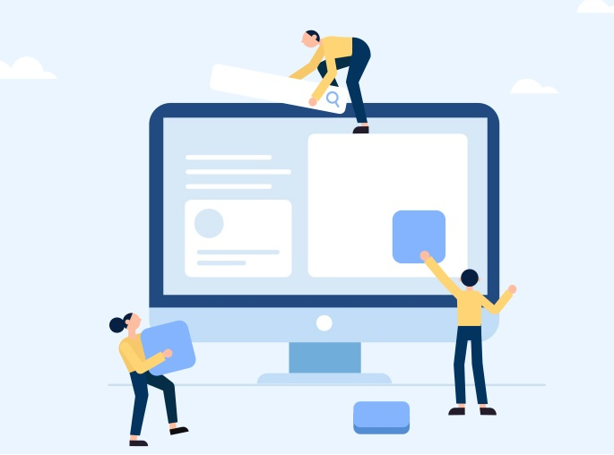
Feature Enhancement :
There will be so many new features are going to add in Zippy Delivery by introducing particular technology and tools which required we can update the working of it .
If user order food from the application the notification directly goes to user Email.
If we want search restaurant by rating there will be a search bar for user .
User can also track the location of the food delivery person.

Slide 22


Any Queries ?
Zippy delivery

Slide 23
Thank You …
Zippy Delivery

Slide 24

Project Walk
Zippy delivery
Through

